Slide 1
Installation Guide
(Eclipse Plug-in － JUtils 3.1)
2008. 12. 16
CODELABOR
Shin Sang Jae (codelabor@gmail.com)

Slide 2
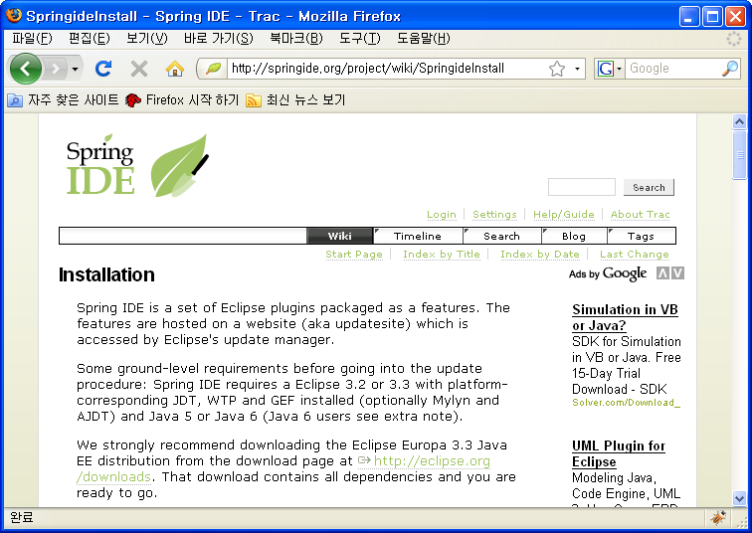
JUtils
Site
Officical Site: http://eclipse-jutils.sourceforge.net/

Slide 3
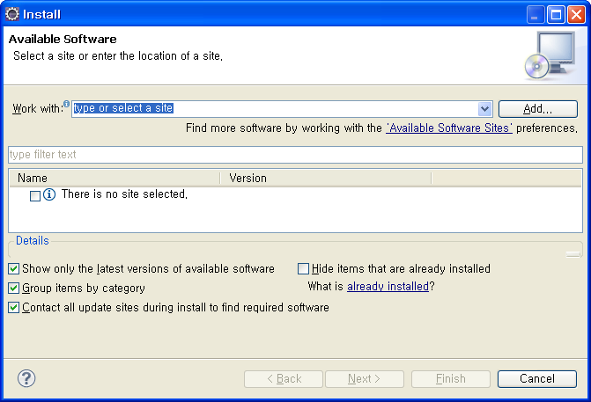
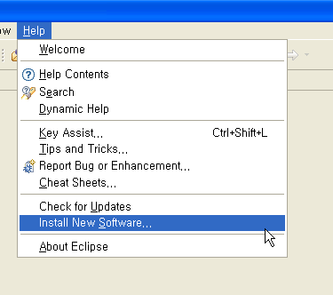
JUtils
Download
Download Site URL: http://sourceforge.net/projects/eclipse-jutils/files/
Menu
  Help > Install New Software...
Install Window
  Work With: > Add

Slide 4
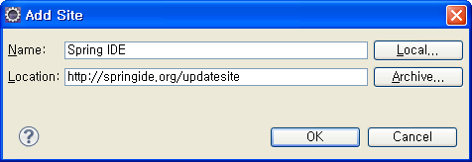
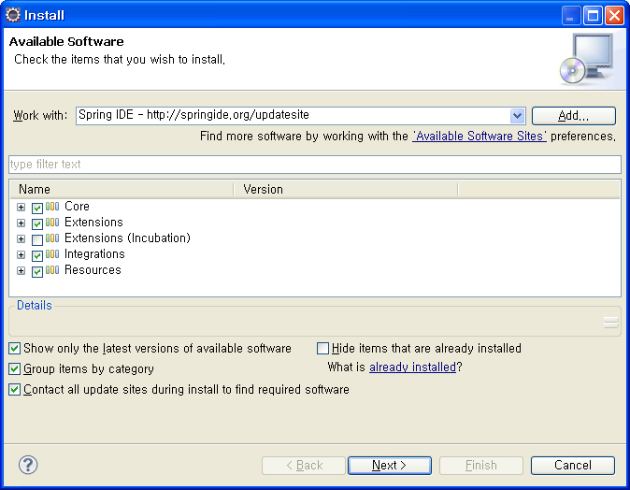
JUtils
Add Site
Add Site Windows
  Name: JUtils
  Location: http://springide.org/updatesite
  Uncheck Extensions (Incubation)

Slide 5
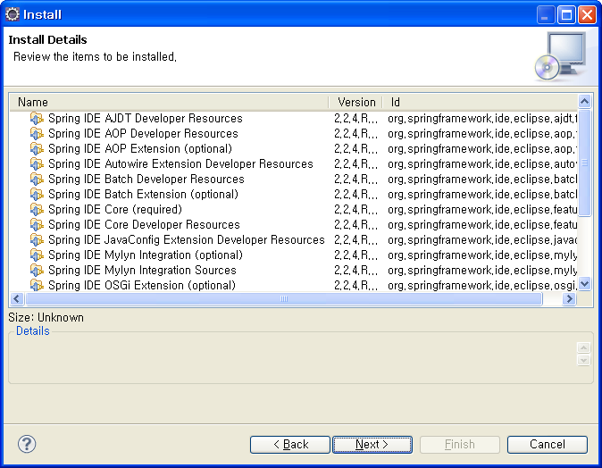
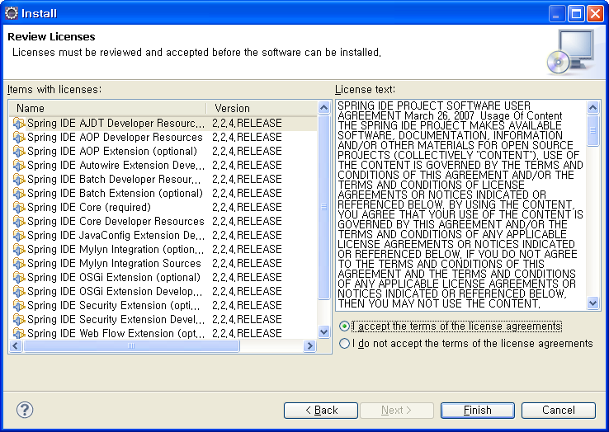
JUtils
Install
Install Details Window
Accept the terms of the license agreements

Slide 6
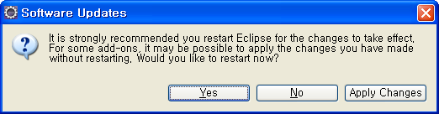
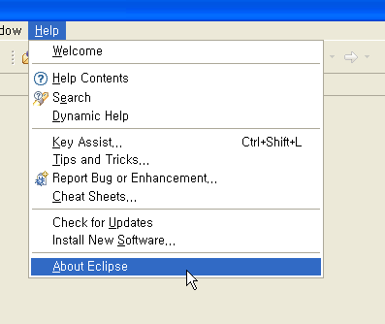
JUtils
Software Updates
Software Updates Window
  Restart
Menu
  Help > About Eclipse

Slide 7
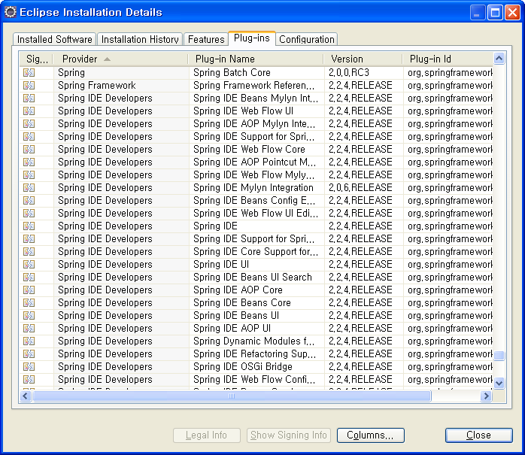
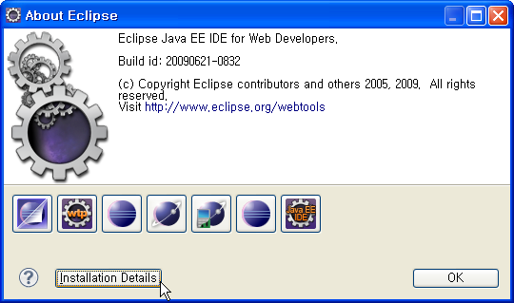
JUtils
Software Updates
About Eclipse Window
  Install Details
Eclipse Installation Details Window
  Plug-ins

Slide 8
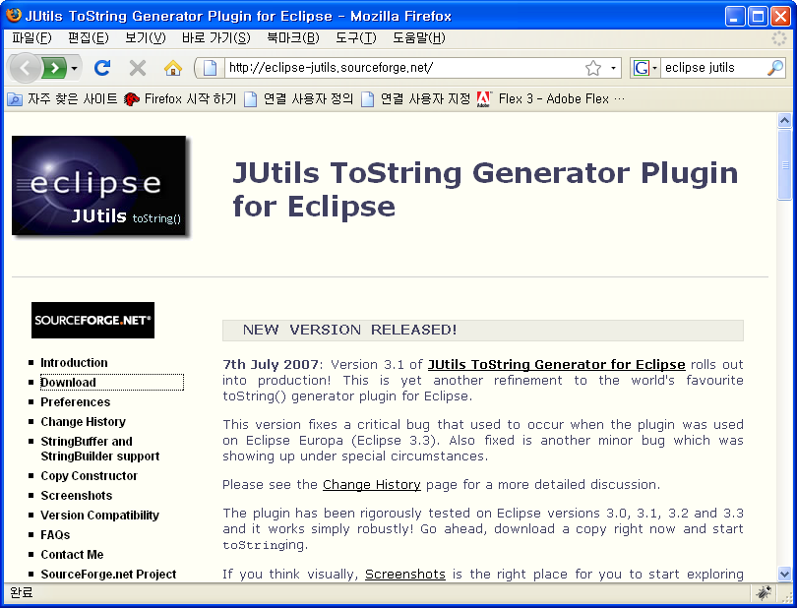
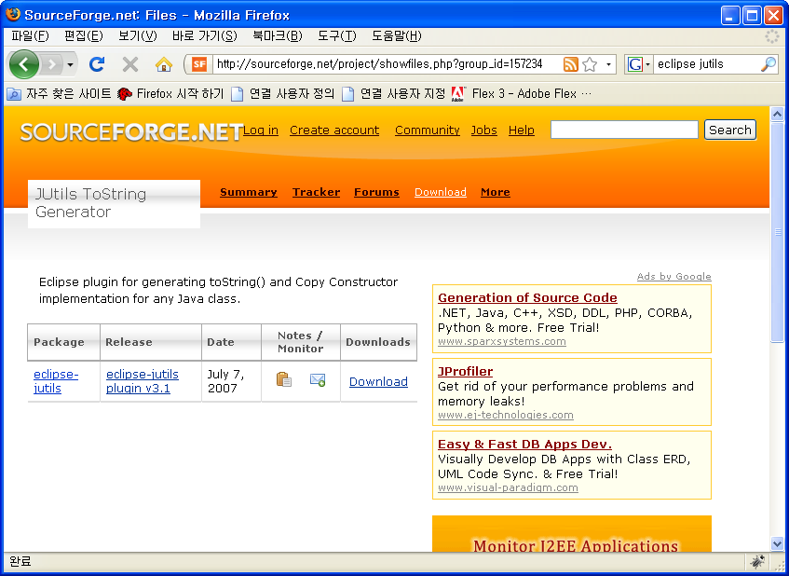
JUtils
Download
Eclipse toString() generator plug-in
Official Site URL: http://eclipse-jutils.sourceforge.net/
Download Site URL: http://sourceforge.net/project/showfiles.php?group_id=157234
Eclipse update site URL: N/A

Slide 9


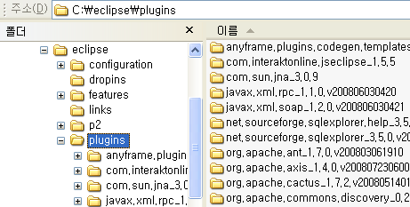
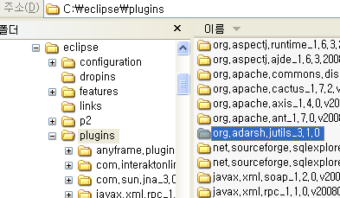
JUtils
Install
Download File: org.adarsh.jutils_3.1.0.zip
Unzip
Copy into Eclipse plugin directory

Slide 10
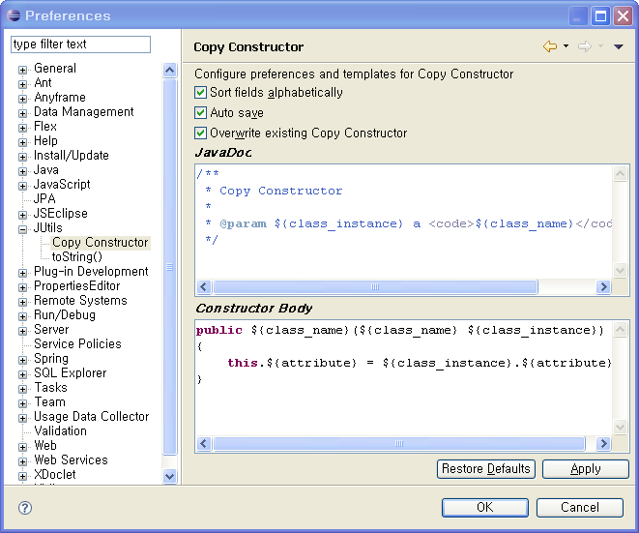
JUtils
Configuration
Windows > Preferences
Check sort fields alphabetically
Check auto save

Slide 11
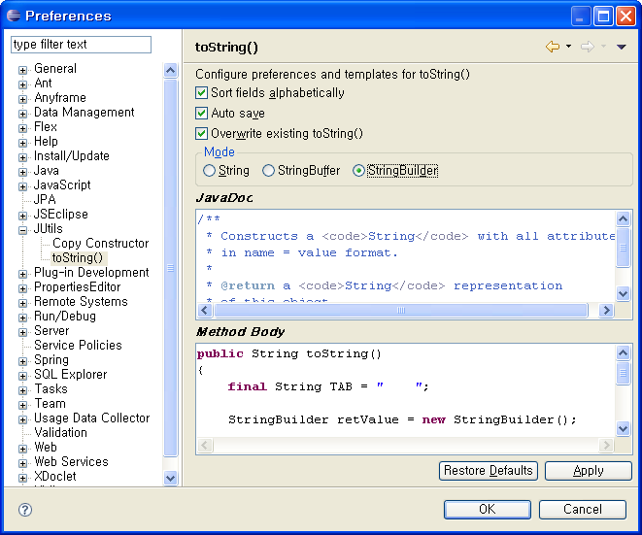
JUtils
Configuration
Windows > Preferences
Check sort fields alphabetically
Check auto save
Select StringBuilder

